Slide 1
Malaria Prevention
@INS_cameroun #CameroonMIS #CamerounEIP

Slide 2
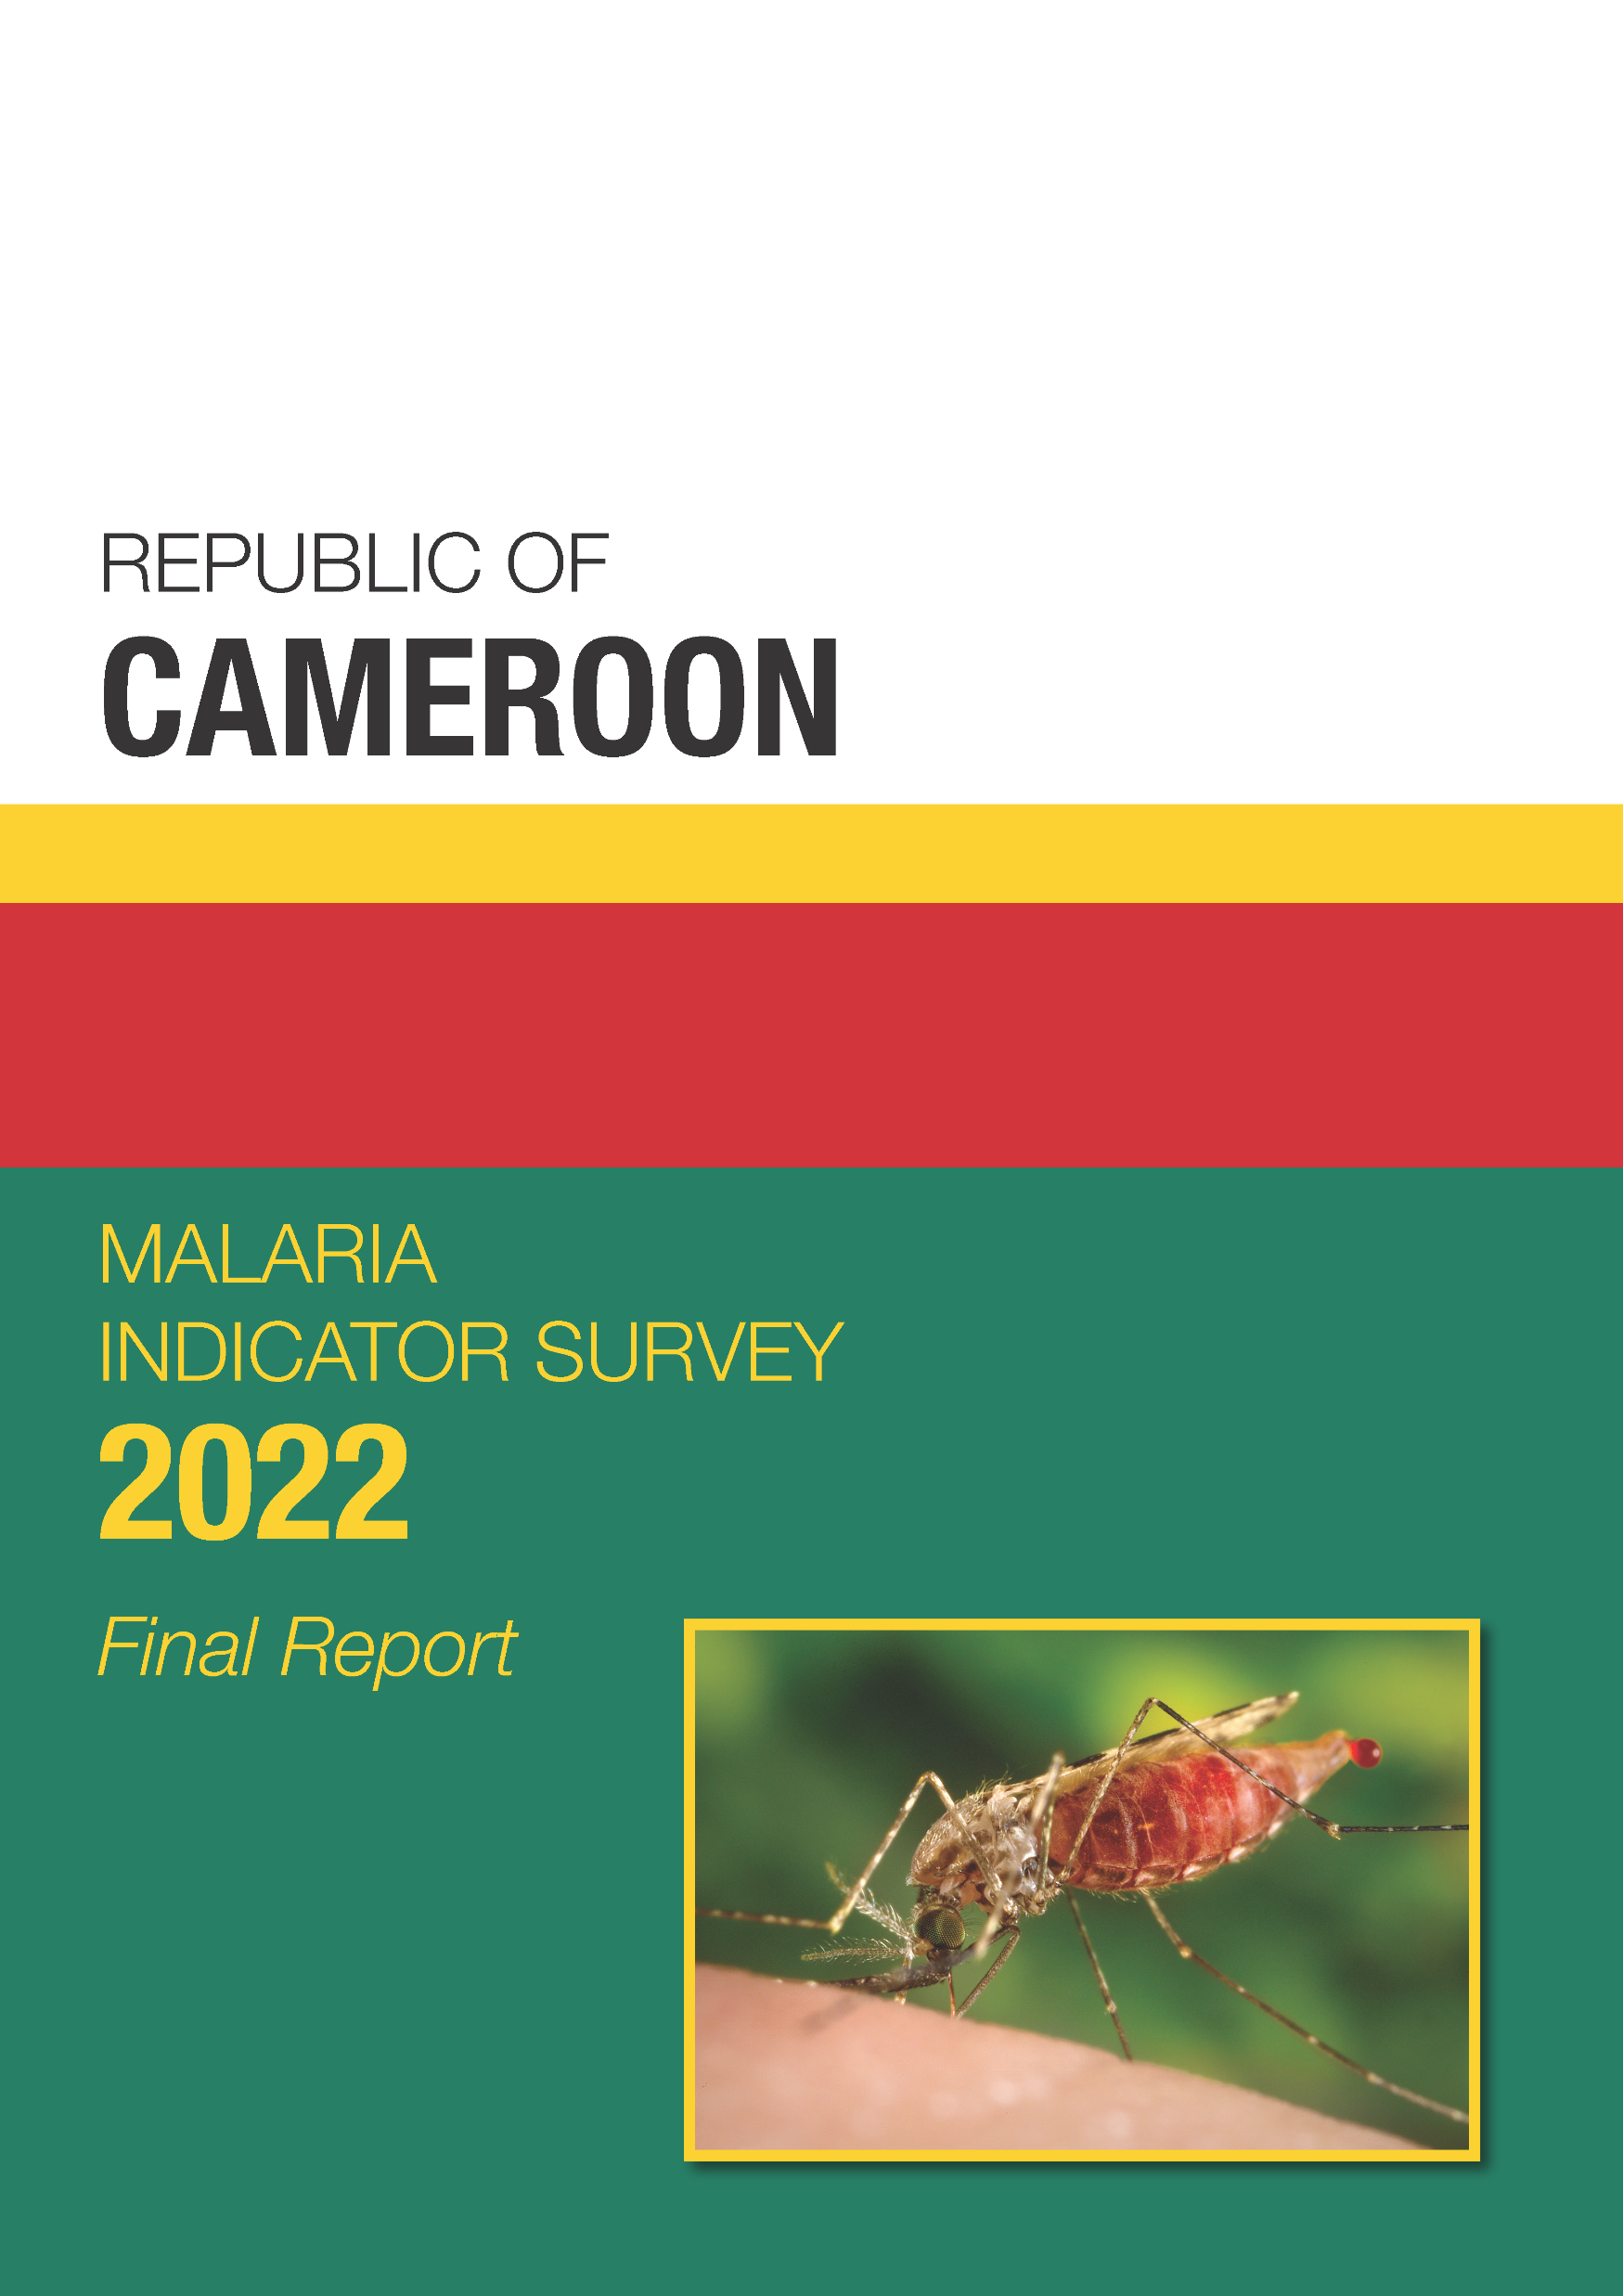
Insecticide-treated nets (ITNs)
Malaria in pregnancy
Find these data in Chapter 3 of the Final Report

Slide 3
Insecticide-treated Net (ITN) Ownership
Percent of households with at least one ITN and percent of households with:
Notes:
75% of households own at least 1 mosquito net; 72% own at least one ITN.
Table 3.1

Slide 4
ITN Ownership by Wealth
Percent of households with at least one ITN
Poorest households
Wealthiest households
Notes:
91% of households in the lowest wealth quintile own at least 1 ITN compared to 62% of households in the highest wealth quintile.
Table 3.1

Slide 5
ITN Ownership by Region
Percent of households with at least one ITN
Cameroon
72%
Far North 97%
North 94%
Northwest 66%
Adamawa 91%
Southwest 59%
West 59%
Centre 55%
Littoral 71%
East 64%
Douala 68%
Yaoundé 56%
South 68%
Notes:
The percentage of households with at least one ITN is highest in the Far North (97%), North (94%), and Adamawa (91%) regions, and lowest in the Centre (55%), Yaoundé (56%), West (59%) and South-West (59%) regions.
Table 3.1

Slide 6
Trends in ITN Ownership
Percent of households with at least one ITN and percent of households with at least one ITN
for every two people in the household
1+ ITN
1+ ITN for every 2 people
In DHS surveys in Cameroon until 2011, the definition of an ITN included nets that had been soaked in an insecticide against mosquitoes within the previous 12 months. Since 2011, all mosquito nets distributed are Long-Lasting Treated Nets (LLINs).
Notes:
Ownership of ITNs increased a great deal between 2004 and 2018, with little change since.

Slide 7
Source of ITNs
Percent distribution of ITNs in interviewed households by source of net
Total ≠ 100% due to rounding
Notes:
The vast majority of ITNs in households were received during mass distribution campaigns.
Table 3.2

Slide 8
Household Coverage of ITNs
Percent distribution of households
Total ≠ 100% due to rounding
Notes:
Nearly half of households have at least 1 ITN for every 2 people in the household. 3 in 10 households have no ITNs.

Slide 9
ITN Access and Use
Percent of household population with access to an ITN and percent who slept under an ITN the night before the survey
Notes:
Overall, 64% of the household population has access to ITNs and 54% slept under an ITN the night before the survey. ITN access and use are higher in rural areas than in urban areas including Yaoudé and Douala.
Tables 3.3, 3.4, 3.8

Slide 10
Trends in ITN Access and Use
Percent of household population with access to an ITN and percent who slept under an ITN the night before the survey
Access to an ITN
Slept under an ITN
In DHS surveys in Cameroon until 2011, the definition of an ITN included nets that had been soaked in an insecticide against mosquitoes within the previous 12 months. Since 2011, all mosquito nets distributed are Long-Lasting Treated Nets (LLINs).
Notes:
Between 2004 and 2022, the percentage of the household population with access to an ITN increased a great deal, from 1% in 2004 to 64% in 2022. Similarly, the percentage of the population who slept under an ITN the night prior to the interview rose from 1% to 54% over the same period.

Slide 11
Use of ITNs
Percent who slept under an ITN
the night before the survey among
all households
Percent who slept under an ITN
the night before the survey among
households with at least one ITN
Notes:
58% of children under age 5 in all households slept under an ITN the night prior to the interview. In households with at least one ITN, the figure was 69%. Among pregnant women in all households, 63% slept under an ITN the night before the interview, and in households with at least one ITN, 79% of women slept under an ITN.
Tables 3.6, 3.7

Slide 12
Children’s Use of ITNs by Region
Percent of children under age 5 who slept under an ITN the night before the survey
Cameroon
72%
Far North 83%
North 73%
Northwest 40%
Adamawa 62%
Southwest 43%
West 33%
Centre 42%
Littoral 60%
East 42%
Douala
56%
Yaoundé 48%
South 53%
Notes:
The percentage of children under age 5 who slept under an ITN the night before the survey was highest in Far North (83%) and North (73%) regions, and lowest in West (33%), Centre (42%), and East (42%) regions.
Table 3.6

Slide 13
Trends in ITN Use among Children and Pregnant Women
Percent of children under age 5 and pregnant women age 15-49 who slept under an ITN the night before the survey
Pregnant women
Children under age 5
In DHS surveys in Cameroon until 2011, the definition of an ITN included nets that had been soaked in an insecticide against mosquitoes within the previous 12 months. Since 2011, all mosquito nets distributed are Long-Lasting Treated Nets (LLINs).
Notes:
Between 2004 and 2022, there has been a great increase in ITN use among children under age 5 (1% to 58%) and pregnant women (2% to 63%).
Tables 3.6, 3.7

Slide 14
Reasons for Not Using a Mosquito Net
Among mosquito nets not used the night before the survey, percent by reason given for not using the net
Notes:
The most common reason by far for not using a mosquito net the night before the survey was that the unused net was extra or being saved for later.
Table 3.8

Slide 15
Insecticide-treated nets (ITNs)
Malaria in pregnancy
Find these data in Chapter 3 of the Final Report

Slide 16
Intermittent Preventive Treatment during Pregnancy (IPTp)
Percent of women age 15-49 with a live birth in the two years before the survey who received:
Notes:
8 in 10 women received one or more doses of intermittent preventive treatment during pregnancy; nearly half received 3 or more doses.
Table 3.13

Slide 17
Trends in IPTp
Percent of women age 15-49 with a live birth in the two years before the survey who received:
IPTp1+
IPTp2+
IPTp3+
Notes:
Between 2004 and 2022, the percent of women who took one or more doses of intermittent preventive treatment rose drastically (1% to 83%).

Slide 18
Key Findings
72% of households own at least one ITN.
64% of the household population has access to an ITN.
54% of household members, 58% of children under age 5, and 63% of pregnant women slept under an ITN the night before the survey.
46% of women took 3+ doses of SP/Fansidar.

